Slide 1
Introduction to Networking
CN 121
Lecture 2 – Networking Media Fundamentals

Slide 2
Overview
Data is represented by computers and other telecommunication devices using signals.
Signals are transmitted in the form of electromagnetic energy from one device to another.
Electromagnetic signals travel through vacuum, air or other transmission media.

Slide 3
Overview
Transmission/Networking medium is the means through which we send our data from one place to another.
The first layer (physical layer) of Communication Networks OSI Seven layer model is dedicated to the transmission media, we will study the OSI Model later

Slide 4
Electromagnetic Spectrum for Transmission Media
Electromagnetic spectrum, the entire distribution of electromagnetic radiation according to frequency or wavelength.
The electromagnetic spectrum of radiation is the basis for all telecommunications signals, carried by both wired and wireless media.

Slide 5
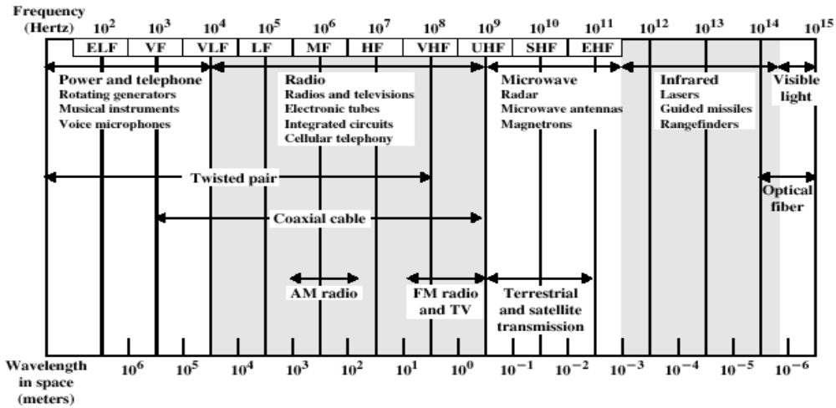
Electromagnetic Spectrum for Transmission Media

Slide 6
Classes of Networking Media
Conducted or guided media
  use a conductor such as a wire or a fiber optic cable to move the signal from sender to receiver.
Wireless or unguided media
  use radio waves of different frequencies and do not need a wire or cable conductor to transmit signals.

Slide 7
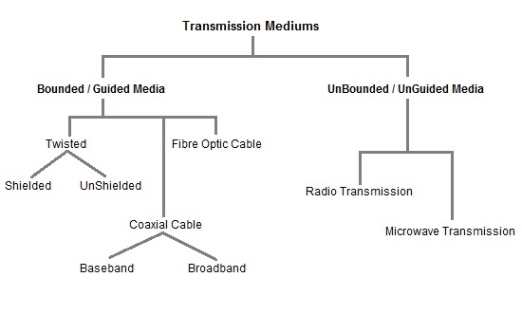
Classes of Networking Media

Slide 8
General Terminology
Links that can be used in both directions at the same time, are called full-duplex links e.g. a telephone.
Links that can be used in either direction, but only one way at a time, are called half-duplex links e.g. a walkie-talkie radio.
Links that allow traffic in only one direction, are called simplex links. An example of simplex communications
household radio set, which can receive data from radio stations but cannot transmit.

Slide 9
General Terminology
Bandwidth:
  In analogue signal a bandwidth is the difference between the highest and lowest frequencies contained in the signal.
  Or the bandwidth is the range, or band, of frequencies that a transmission medium can carry in a given period of time. Measured in hertz (Hz), or cycles per second.
  In digital context the bandwidth is the same as data rate which is amount of data transferred per second. Measured in bits per second.

Slide 10
General Terminology
Latency is the time it takes a signal to be passed from one device to another on a network.
Throughput is the amount of actual data that is being carried at any given time during a connection.
  Throughput can be affected by the devices attached to the network, layout of the network, the characteristics of the data being sent and number of people using the network.

Slide 11
Design Factors for Networking Media
Bandwidth: All other factors remaining constant, the greater the band-width of a signal, the higher the data rate that can be achieved.
Transmission impairments. Limit the distance a signal can travel.
Interference: Competing signals in overlapping frequency bands can distort or wipe out a signal.
Number of receivers: Each attachment introduces some attenuation and distortion, limiting distance and/or data rate.
Cost and Ease of Installation

Slide 12
Guided Networking Media
Transmission capacity depends on the distance and on whether the medium is point-to-point or multipoint.
Examples
  Twisted pair wires
  Coaxial cables
  Optical fiber

Slide 13
Twisted Pair Wires
Consists of two insulated copper wires arranged in a regular spiral pattern to minimize the electromagnetic interference (crosstalk) between adjacent pairs.
Often used at customer facilities and also over distances to carry voice as well as data communications.
The most common application of the twisted pair is the telephone system.

Slide 14
Types of Twisted Pair
STP (shielded twisted pair)
  The pair is wrapped with metallic foil or braid to insulate the pair from electromagnetic interference.
  Shielded twisted-pair cables are actually not used very often these days.
UTP (unshielded twisted pair)
  Each wire is insulated with plastic wrap, but the pair is encased in an outer covering.

Slide 15
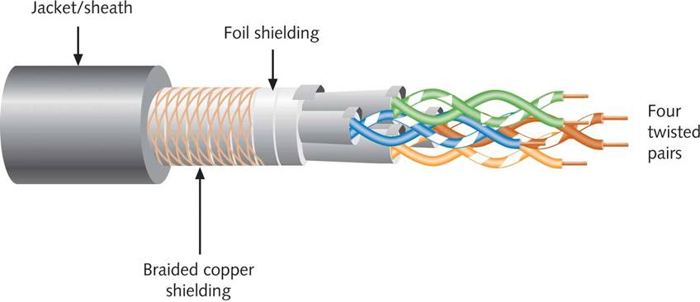
STP (Shielded Twisted-Pair)

Slide 16
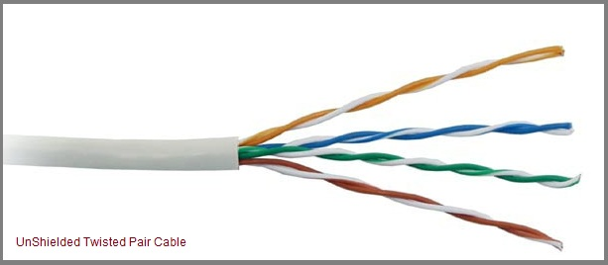
UTP (Unshielded Twisted Pair

Slide 17
UTP (Unshielded Twisted-Pair)
Less expensive, less resistant to noise than STP
Categories:
  CAT 3 (Category 3): 4 twisted pairs, up to 10 Mbps of data
  CAT 4 (Category 4): 4 twisted pairs, 16 Mbps throughput
  CAT 5 (Category 5): 4 twisted pairs, 100Mbps and higher
  CAT 5e (Enhanced Category 5): 4 twisted pairs, 100Mbps and higher higher twist ratio
  CAT 6 (Category 6): 4 twisted pairs, 100Mbps and higher, six times the throughput of CAT 5
  CAT 6e (Enhanced Category 6): 4 twisted pairs, 10 Gbps, reduced attenuation and crosstalk
  CAT 7 (Category 7): 4 twisted pairs, signal rates up to 1 GHz

Slide 18
Comparing STP and UTP
Throughput: STP and UTP can both transmit data at 10, 100, and 1000 Mbps
  Depending on grade of cabling and transmission method used
Cost: STP usually more expensive than UTP
Connector: Both use RJ-45 and RJ-11
Noise Immunity: STP more noise-resistant (Shielding reduces EMI and RFI).

Slide 19
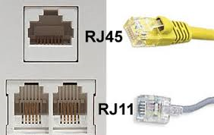
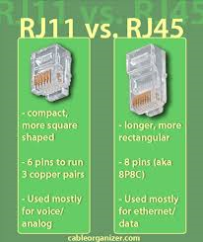
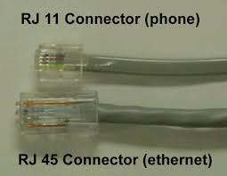
RJ-45 & RJ-11 Connectors
RJ: Registered jack

Slide 20
Twisted Pair Advantages
Inexpensive and readily available
Flexible and light weight
Easy to work with and install

Slide 21
Twisted Pair Disadvantages
Susceptibility to interference and noise
Attenuation problem
  For analog, repeaters needed every 5-6km
  For digital, repeaters needed every 2-3km
Relatively low bandwidth (3000Hz)

Slide 22
Coaxial Cable (or Coax)
Is constructed from one central copper wire that is covered with a plastic insulator, called a dielectric, and shielded from interference by a foil wrapping or braid.
Used for cable television, LANs, telephony.

Slide 23
Coaxial Cable (or Coax)
All coax cables share the same basic structure, but vary in the size of the central copper core and cable impedance, measured in ohms.
Higher impedance means higher resistance to a changing current.
Higher resistance means greater signal loss over a distance.

Slide 24
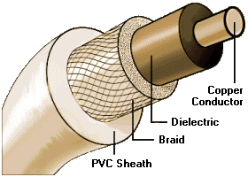
Coax Layers
outer jacket
(polyethylene)
shield
(braided wire)
insulating material
copper or aluminum
conductor

Slide 25
Types of Coax
Classification | Impedance | Implementation
RG-6 | 93 ohms | Cable TV
RG-8 | 50 ohms | Thicknet (10Base-5)
RG-11 | 75 ohms | Cable TV
RG-58/U | 50 ohms | Thinnet (10Base-2)
RG-58 A/U | 50 ohms | Thinnet (10Base-2)
RG-58 C/U | 50 ohms | Thinnet (10Base-2)
RG-59 | 75 ohms | ARCNET and Cable TV
RG-62 | 93 ohms | ARCNET and IBM mainframe
RG : Radio Grade
Thicknet: thick ethernet
Thinnet: thin ethernet
ARCNET:A low-level network protocol.

Slide 26
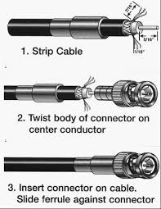
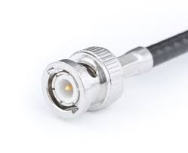
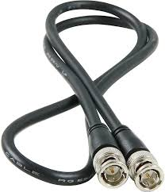
Coaxial cable connector
BNC connector: Bayonet Neill–Concelman.

Slide 27
Coax Advantages
Higher bandwidth
  400 to 600Mhz
  up to 10,800 voice conversations
Can be tapped easily (pros and cons)
Much less susceptible to interference (like electromagnetic interference (EMI), radio frequency interference (RFI)) than twisted pair.

Slide 28
Coax Disadvantages
High attenuation rate makes it expensive over long distance
Bulky

Slide 29
Fiber Optic Cable
A transmission media that uses glass or plastic fiber to carry light (laser) signals.
Relatively new transmission medium used by telephone companies in place of long-distance trunk lines.
Also used by private companies in implementing local data communications networks.
It is designed to pass specific types of light waves over long distances with very little attenuation.
Light source can either be an injection laser diode (ILD) or light-emitting diodes (LED)

Slide 30
Fiber Optic Layers
consists of three concentric sections
plastic jacket
glass or plastic
cladding
fiber core

Slide 31

Fiber Optic Cable
Fiber construction

Slide 32
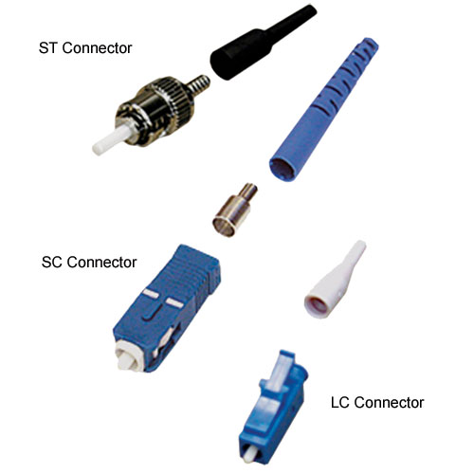
Fiber Optic Cable
Straight Tip
Subscriber Connector
Fiber-optic cable connectors
Local Connector

Slide 33
Fiber Optic Types
Single Mode Fiber: Fiber-optic cable that carries a single transmission signal.
Multimode Fiber: Fiber-optic cable that supports multiple concurrent communication signals.

Slide 34
Difference between SM & MM
The most fundamental differences are the size of the fiber’s core and the associated attenuation or loss and bandwidth of the fiber.
SM fiber has a core diameter of nominally 9μm while MM fiber has either a 50μm or 62.5μm core diameter.

Slide 35
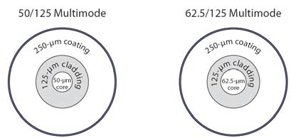
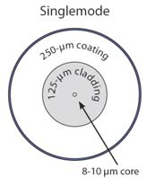
Difference between SM & MM
The basic rule of thumb is that the smaller the core diameter, the higher the fiber’s bandwidth and the lower the attenuation (loss in dB per kilometer).

Slide 36
Difference between SM & MM
MM provides high bandwidth at high speeds over medium distances while SM span really long distances because it can transmit data 50 times farther than MM fiber.
Lasers are the primary light sources used with SM while MM usually uses light emitting diodes.

Slide 37
Fiber Optic Advantages
Greater capacity (bandwidth of up to 2 Gbps)
Smaller size and lighter weight
Lower attenuation
Immunity to environmental interference
Highly secure due to tap difficulty and lack of signal radiation

Slide 38
Fiber Optic Disadvantages
Expensive purchase and install.
Requires highly skilled installers.
Adding additional nodes is difficult.

Slide 39
Wireless (Unguided Media) Transmission
Transmission and reception are achieved by means of an antenna
Directional
  Transmitting antenna puts out focused beam transmitter and receiver must be aligned.
Omnidirectional
  Signal spreads out in all directions can be received by many antennas

Slide 40
Wireless Examples
Terrestrial microwave
Satellite microwave
Infrared

Slide 41
Terrestrial Microwave
Also known as microwave radio transmits voice and data at 45 megabits per second through the atmosphere.
Used for long-distance telephone service (Cellular technologies), Wi-Fi and Bluetooth services.
Uses radio frequency spectrum, from 2 to 40 Ghz
Requires unobstructed line of sight between source and receiver.
Curvature of the earth requires stations (repeaters) ~50 km apart.

Slide 42
Microwave Transmission Disadvantages
Line of sight requirement.
Expensive it needs towers and repeaters.
Subject to interference such as passing airplanes and rain.

Slide 43
Satellite Microwave Transmission
A microwave relay station in space can relay signals over long distances
Geostationary satellites (GEO)
  Remain above the equator at a height of ~35,786km (geosynchronous orbit)
  Travel around the earth in exactly the time the earth takes to rotate

Slide 44
Satellite Microwave Transmission
Geostationary (GEO) satellites
  High power is needed to send microwave signals.
  High latency.
Low Earth orbit (LEO)
  160 kilometers up and 2,000 kilometers.
  Used for handheld satellite communications.
Medium Earth orbit (MEO).
  2,000 kilometers and about 34,780 kilometers up.
  Used for GPS networks.

Slide 45
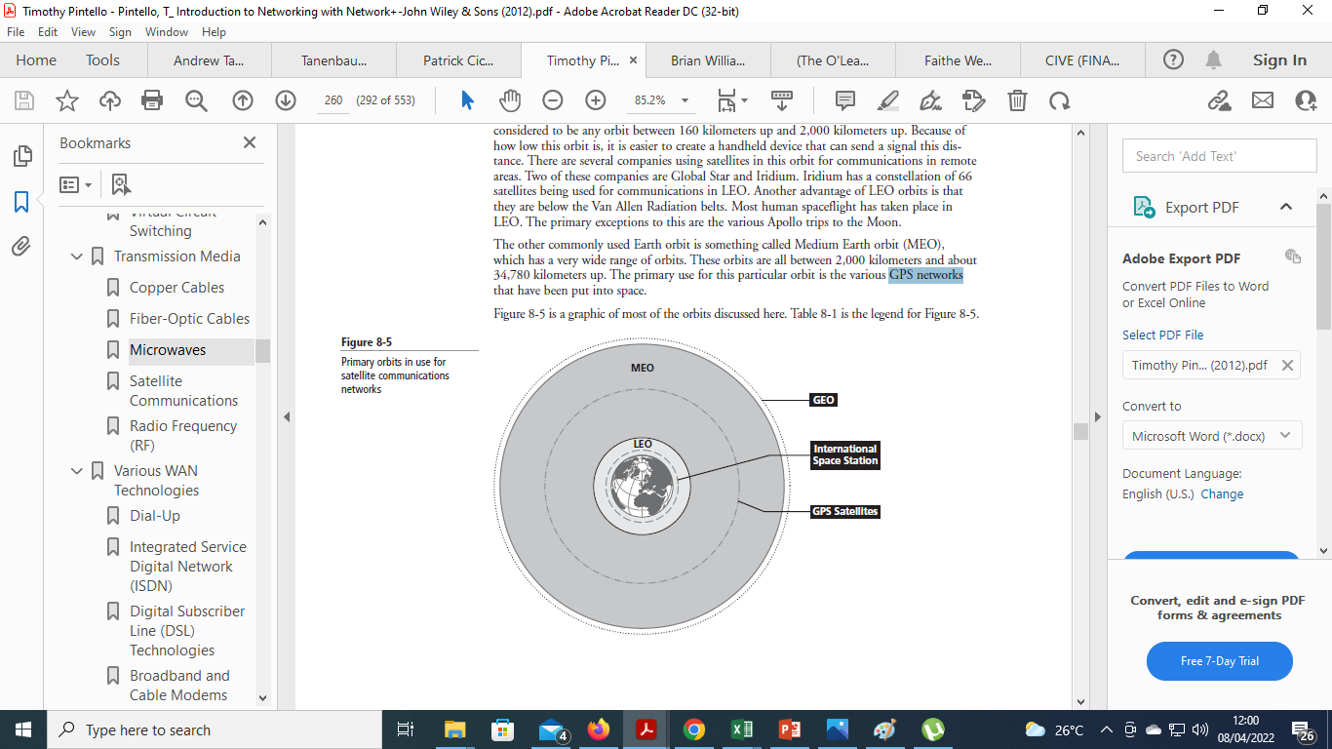
Satellite Microwave Transmission
GEO, MEO, LEO

Slide 46
Satellite Transmission Links
Earth stations communicate by sending signals to the satellite on an uplink.
The satellite then repeats those signals on a downlink.
The broadcast nature of the downlink makes it attractive for services such as the distribution of television programming.

Slide 47
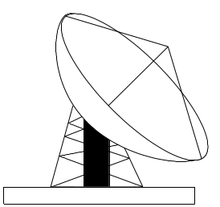
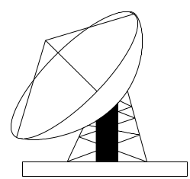
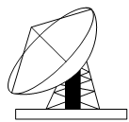
Satellite Transmission Process
satellite
transponder
dish
dish
35,786 km
uplink station
downlink station

Slide 48
Satellite Transmission Applications
Television distribution
  A network provides programming from a central location
  Direct broadcast satellite (DBS)
Long-distance telephone transmission
  High-usage international trunks
Private business networks

Slide 49
Principal Satellite Transmission Bands
C-band: 4(downlink) - 6(uplink) GHz
  the first to be designated
Ku-band: 12(downlink) -14(uplink) GHz
  rain interference is the major problem
Ka-band: 19(downlink) - 29(uplink) GHz
  equipment needed to use the band is still very expensive

Slide 50
Infrared
Uses transmitters/receivers (transceivers) that modulate non-coherent infrared light.
Transceivers must be within line of sight of each other (directly or via reflection).
Uses a license free band (2.4GHz).
Infrared ports can be found on some laptop computers, PDAs, digital cameras, and printers, TV remote-control as well as wireless mice.

Slide 51
Infrared
Drawbacks
  Line-of-sight communication
  Unlike microwaves, infrared does not penetrate walls.
  Transmission is confined to short range.

Slide 52
Reading assignment
Introduction to Networking with Network1 by Timothy Pintello
Chapter 3 and Chapter 8 (part of Transmission media)

